Slide 1
Cyrus McCormick
By: Dinesh Maganti

Slide 2
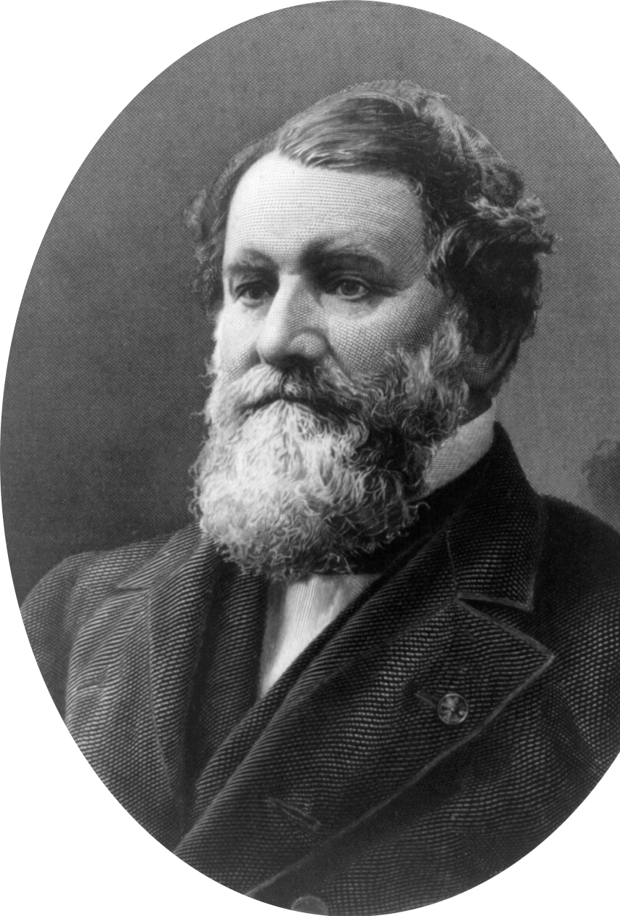
Introduction
Cyrus McCormick was an inventor and a business man. He was the one who invented the Reaper. He lived on a farm with his dad, Robert McCormick. Both Cyrus and his father loved to think and invent about new things.

Slide 3
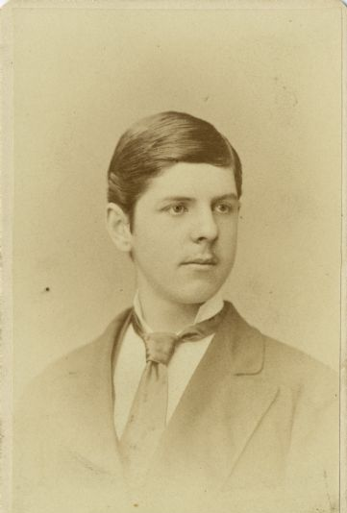
Early Life
In his early life, Cyrus McCormick worked on the farm. He used to help pull out grains. This was pretty hard and tiring for him, so he wanted to find out a way to make this job easier for him. Cyrus also loved to travel outside his farm, but his father doesn’t let him go too far.

Slide 4
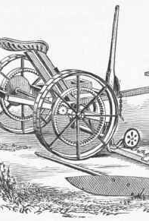
The Reaper
At the age of 22, he started to make a machine that pulls out grains. His father also tried to make the Reaper, but his invention failed. After sometime, Cyrus tried to make it, and his worked. In 1831, he sold his first Reaper. This invention was a great success and it was also very popular. When he sold his Reaper, he had finally got the chance to go outside his farm. The success of his Reaper and him getting the privilege to go outside his farm made Cyrus happy.

Slide 5
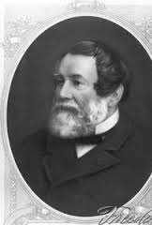
His Later years
In his later years, Cyrus McCormick made his own company called the McCormick Harvesting Company. Through out his life, Cyrus made 88 of these Reapers. He later died of stroke. He is now known for inventing the Reaper.

Slide 6
Citation
https://www.google.com/search?q=cyrus+mccormick&oq=cyr&aqs=chrome.0.69i59j69i57j0l2j69i60j0.3483j0j7&sourceid=chrome&ie=UTF-8
https://www.google.com/search?q=the+reaper+machine&oq=the+re&aqs=chrome.0.69i59j69i57j0l2j69i60j0.3807j0j7&sourceid=chrome&ie=UTF-8

